Slide 1




Slide 2


Slide 3
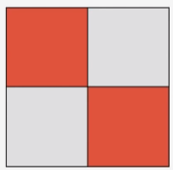
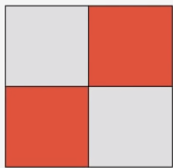


=
=

Slide 4
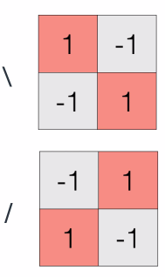

Slide 5
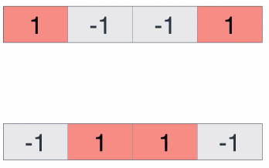

Slide 6
What are the simplest operations we can do on these numbers?

Slide 7
How about adding them?
+ + + = 0
+ + + = 0

Slide 8
How about multiplying them?
x x x = 1
x x x = 1

Slide 9
What mathematical operation can separate these two strings/data parameters?

Slide 10
+ -
- +
+ - - +
+ -
- +
- + + -

Slide 11
Making some rules...
+ -
- +
+ - - +
+1 +1 +1 +1 = +4
+ -
- +
+ - - +
-1 -1 -1 -1 = -4

Slide 12
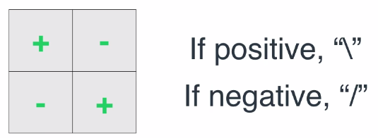
Classifier

Slide 13
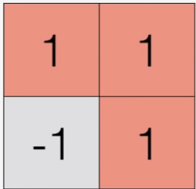
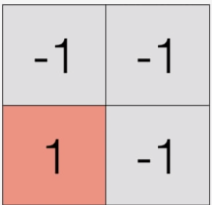
What about these representations?
\
/

Slide 14
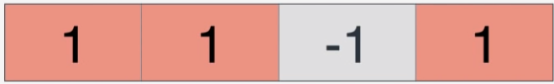
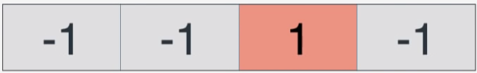
What does the computer see?
\
/

Slide 15
Using our existing classifier...
+ -
- +
+ - - +
\
/
+ -
- +
+ - - +

Slide 16
Using our existing classifier...
+ -
- +
+ - - +
\
/
+1 -1 +1 +1 = +2
+ -
- +
+ - - +
-1 +1 -1 +1 = -2

Slide 17
The computer can actually tell you poorly represented data using classifiers
You want it to be robust

Slide 18
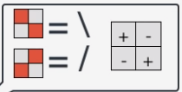

Artificial intelligence
We can distinguish many shapes
Of various scales and sizes...
… but what can a computer do?

Slide 19
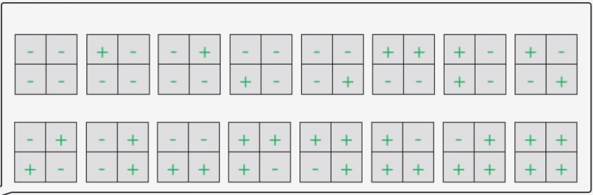
… but what can a computer do?
It can check all the possibilities!

Slide 20

In this case 16 choices of combinations

Slide 21
Artificial intelligence
Start randomly
Try and change each ‘+’ to a ‘-’ and see how the classify performs

Slide 22

Start randomly
Try and change each ‘+’ to a ‘-’ and see how the classifier performs

Slide 23
Start randomly
Try and make some more changes
Try and change each ‘+’ to a ‘-’ and see how the classifier performs

Slide 24
Start randomly
Stop when you are happy about it!
Try and change each ‘+’ to a ‘-’ and see how the classifier performs

Slide 25
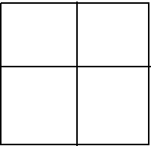
In reality you don't have restrict yourself to +1 and -1…
you can use continuous values...
to check for better possibilities..
0.8 1.2
0.1 0.7
0.9 -1.9
0.2 -0.6
, and so on...

Slide 26
Start with random numbers
Lots of errors
0.8 1.2
0.1 -0.7
less errors

Slide 27
Start with random numbers
Lots of errors
0.8 1.2
0.1 -0.7
Change them slightly...
0.6 -0.5
0.5 -0.9
less errors

Slide 28
Start with random numbers
Lots of errors
0.8 1.2
0.1 -0.7
Change them slightly...
0.6 -0.5
0.5 -0.9
And again...
0.9 0.9
-0.1 1
less errors

Slide 29
Start with random numbers
Lots of errors
0.8 1.2
0.1 -0.7
Change them slightly...
0.6 -0.5
0.5 -0.9
And again...
0.9 0.9
-0.1 1
1 -1
-1 1
less errors

Slide 30
Start with random numbers
Lots of errors
0.8 1.2
0.1 -0.7
Change them slightly...
0.6 -0.5
0.5 -0.9
And again...
0.9 0.9
-0.1 1
Until you get here :)
1 -1
-1 1
less errors

Slide 31
Start with random numbers
Lots of errors
0.8 1.2
0.1 -0.7
Change them slightly...
0.6 -0.5
0.5 -0.9
And again...
0.9 0.9
-0.1 1
Until you get here :)
1 -1
-1 1
Taking the derivative (error function)
that measures how many errors we are making
and then take the gradient that will point us in the direction
until we get to a point where we get few errors...
less errors

Slide 32

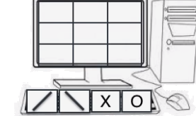
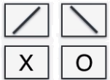
Slightly more complex world

Slide 33
XOXO!!!
Lets see what happens when we press the keys on our screen...

Slide 34
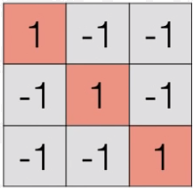
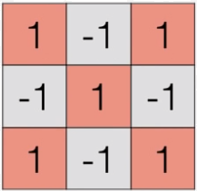
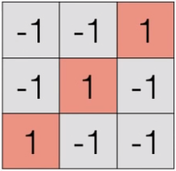
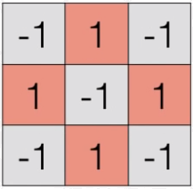
How can we build a classifier that can tell these apart?
\
X
/
O

Slide 35
May be we can start with ‘+’ and ‘-’ as we started out

Slide 36
But the problem is that it misses the point of variations in the data, scaling,
like big letters, small letters, different types… ideally we need to break it down to
smaller data representations and and analyze those...
+ - +
- + -
+ - +

Slide 37
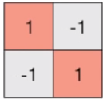

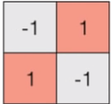

Previous knowledge

Slide 38
Convolution NN

Slide 39
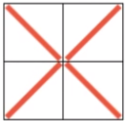
Convolution NN

Slide 40
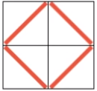
Convolution NN

Slide 41
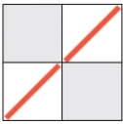
Convolution NN

Slide 42
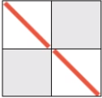
Convolution NN

Slide 43




Convolution NN

Slide 44
Convolution NN
Covolutional layer
Pooling layer
Fully connected layer

Slide 45
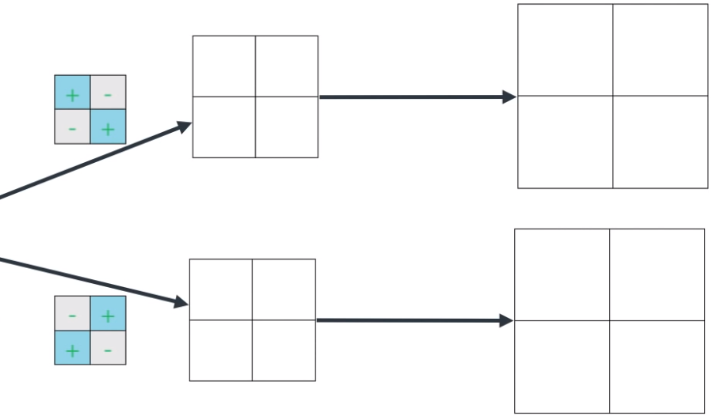
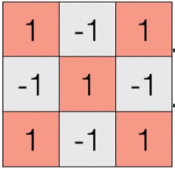
We have our 3x3 data
Filter for backward diagonal
Filter for forward diagonal

Slide 46
Filter for backward diagonal
Filter for forward diagonal

Slide 47
Filter for backward diagonal
+ -
- +
Filter for forward diagonal
Did you find the big number you are looking for?

Slide 48

Filter for backward diagonal
4
+ -
- +
Filter for forward diagonal
Did you find the big number you are looking for?

Slide 49
Filter for backward diagonal
4
+ -
- +
Filter for forward diagonal

Slide 50
Filter for backward diagonal
4 -4
+ -
- +
Filter for forward diagonal

Slide 51
Filter for backward diagonal
4 -4
-4
+ -
- +
Filter for forward diagonal

Slide 52
Filter for backward diagonal
4 -4
-4 4
+ -
- +
Filter for forward diagonal

Slide 53
Filter for backward diagonal
4 -4
-4 4
+ -
- +
Filter for forward diagonal

Slide 54
Filter for backward diagonal
4 -4
- +
+ -
-4 4
Filter for forward diagonal

Slide 55
Filter for backward diagonal
4 -4
- +
+ -
-4 4
-4
Filter for forward diagonal

Slide 56
Filter for backward diagonal
4 -4
- +
+ -
-4 4
-4 4
Filter for forward diagonal

Slide 57
Filter for backward diagonal
4 -4
-4 4
- +
+ -
-4 4
4
Filter for forward diagonal

Slide 58
Filter for backward diagonal
4 -4
-4 4
- +
+ -
-4 4
4 -4
Filter for forward diagonal

Slide 59
4 -4
-4 4
-4 4
4 -4
Convolutional layer Pooling layer
Takes the filter and slides it though the data
I have a treshold…

Slide 60
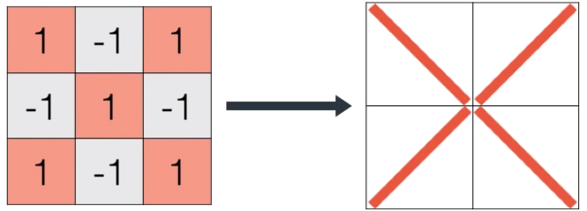
Collating it together
The computer can now make some sense...

Slide 61
Convolution layer and pooling layer
Convolution layer takes a filter and slides it over
The pooling layer checks for a threshold
Fully connected layer
Uses logic to figure out what data it is

Slide 62
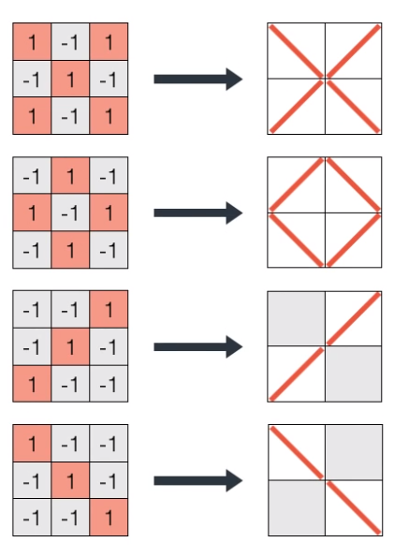
This is the way the computer will see the data
after the convolution and pooling process

Slide 63

But it doesn't see it as a 2x2 matrix but as a string...

Slide 64

But it doesn't see it as a 2x2 matrix but as a string...

Slide 65
But it doesn't see it as a 2x2 matrix but as a string...

Slide 66
But it doesn't see it as a 2x2 matrix but as a string...

Slide 67

Lets encode this as a matrix

Slide 68
Lets encode this as a matrix

Slide 69
Lets encode this as a matrix

Slide 70
Lets encode this as a matrix

Slide 71
Lets encode this as a matrix

Slide 72


Lets encode this as a matrix

Slide 73
Lets encode this as a matrix

Slide 74
Lets encode this as a matrix

Slide 75
Lets encode this as a matrix

Slide 76
Lets encode this as a matrix

Slide 77
This represents our ‘X’

Slide 78
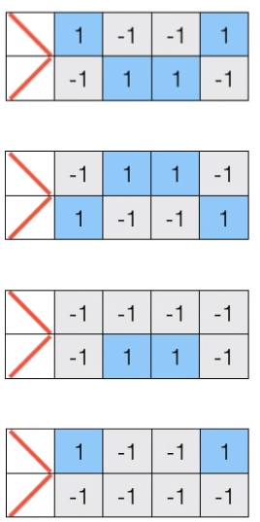
We can do the same process for the other
data representations

Slide 79
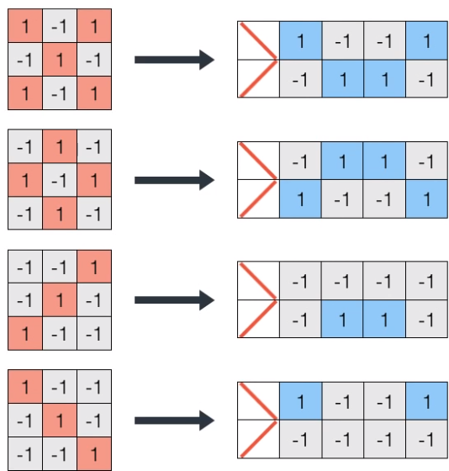
OK, lets create our filters...

Slide 80
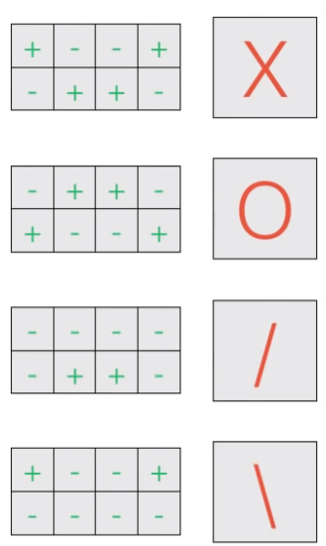

Slide 81
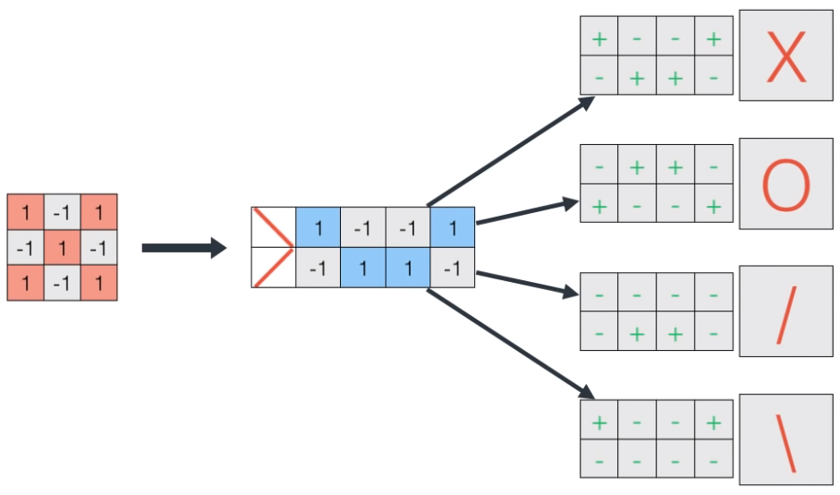
What happens at the filter

Slide 82
+1

Slide 83
+1+1

Slide 84
+1+1+1

Slide 85
+1+1+1+1

Slide 86
+1+1+1+1+1

Slide 87
+1+1+1+1+1+1

Slide 88
+1+1+1+1+1+1+1

Slide 89
+1+1+1+1+1+1+1+1

Slide 90
+1+1+1+1+1+1+1+1=8

Slide 91

+1+1+1+1+1+1+1+1=8
-1 -1 -1 -1 -1 -1 -1 -1=-8
-1+1+1-1+1+1+1+1 =4
+1+1+1+1+1-1-1+1 =4

Slide 92
In summary
We have our data.. the computer reads it using filters to decide if it is an X, an O, a \ or /
The convolution will scan all data
Whenever we get a large number the pooling layer says you have found something
The fully connected helps to make a decision

Slide 93
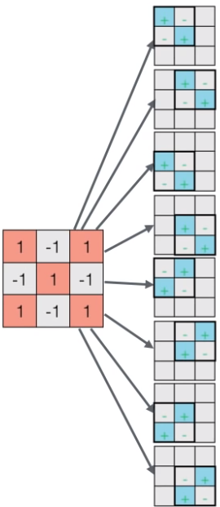

Slide 94
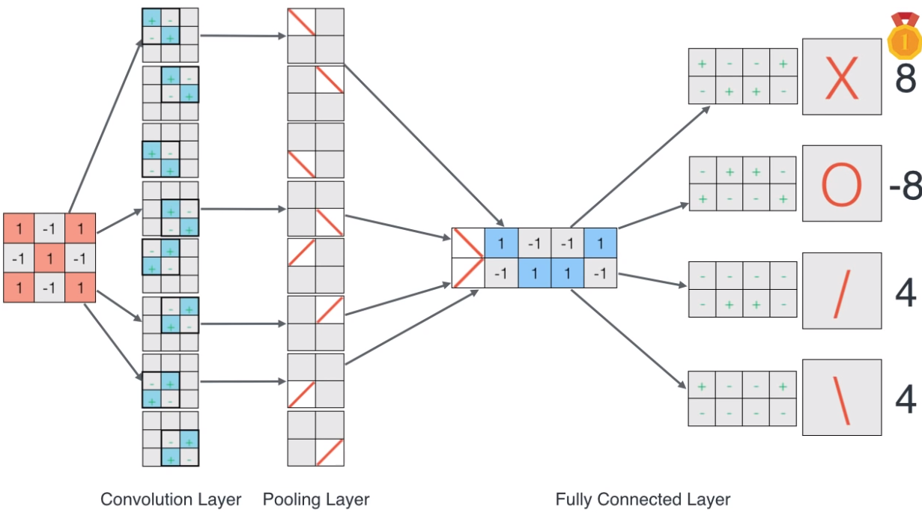

Slide 95
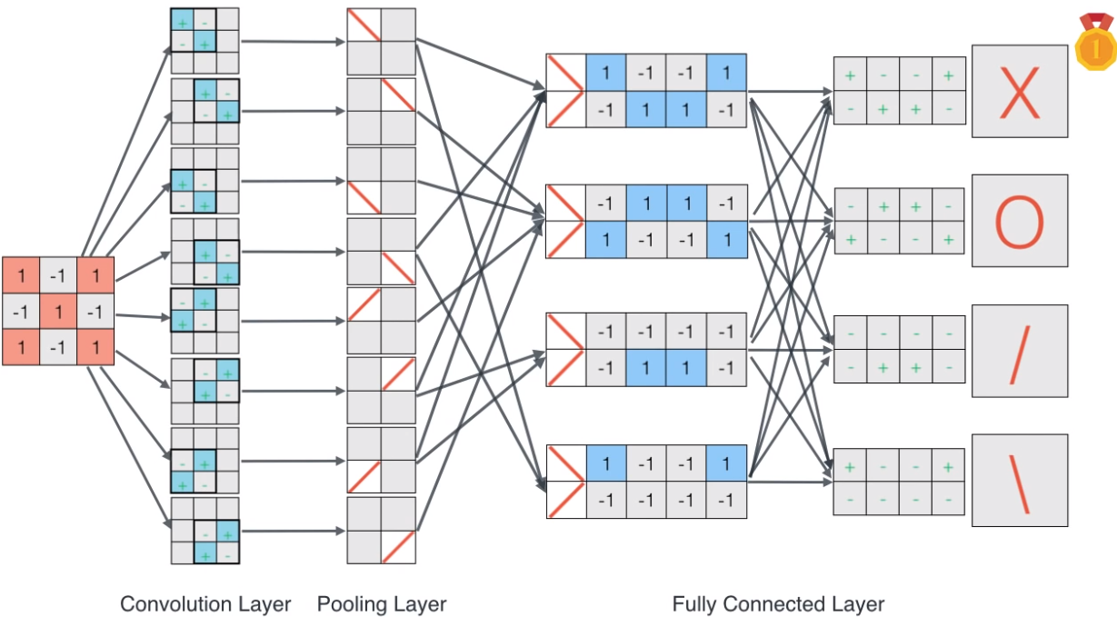

Slide 96
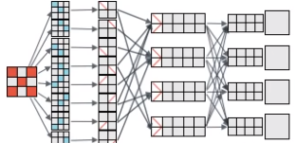
That was a lot of work!
Start with random numbers
Lots of errors

Slide 97
That was a lot of work!
Start with random numbers
Lots of errors
Make slight changes
Few errors

Slide 98
That was a lot of work!
Start with random numbers
Lots of errors
Make slight changes
Reach your goal
Few errors

Slide 99
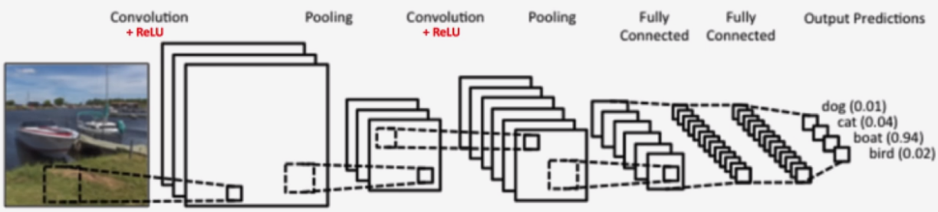
A more advanced problem...

Slide 100
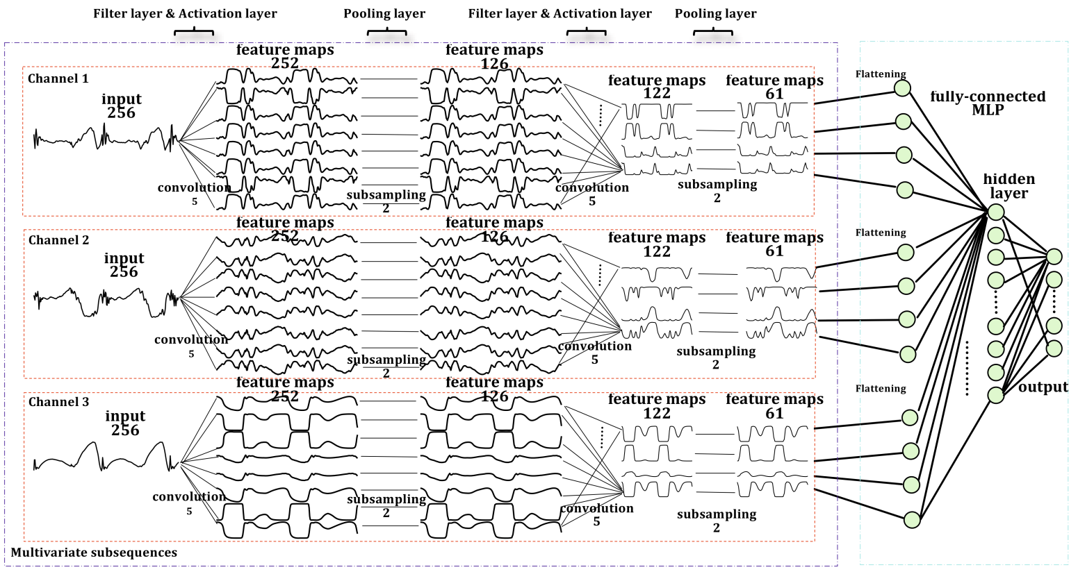
A more advanced problem...

Slide 101
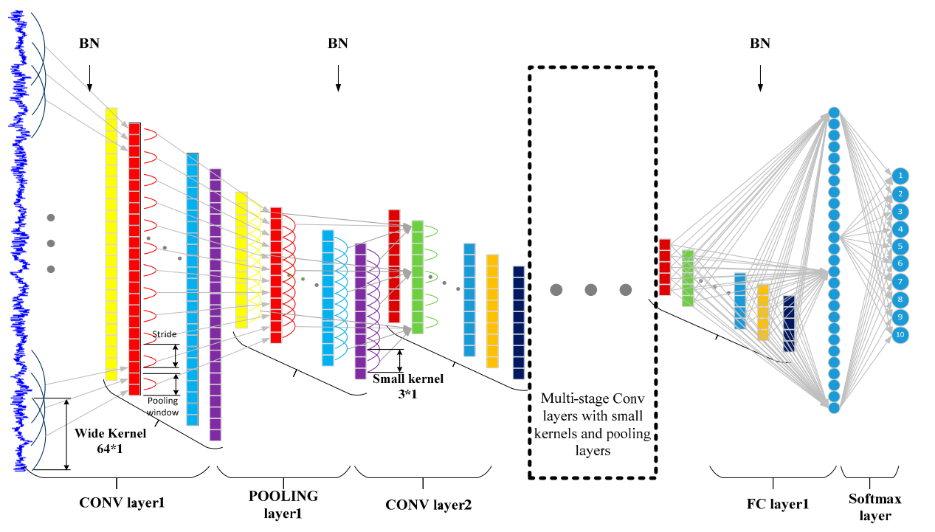
Wei Zhang, Gaoliang Peng, Chuanhao Li, Yuanhang Chen and Zhujun Zhang . A New Deep Learning Model for Fault Diagnosis with Good Anti-Noise and Domain Adaptation Ability on Raw Vibration Signals Sensors 2017, 17, 425; doi:10.3390/s17020425

